Slide 1
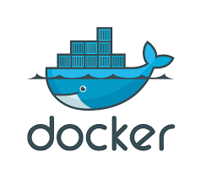
What is Docker
Software container platform. Wraps a piece of software in a filesystem. Contains everything : code, runtime, system tools, system libraries – anything that can be installed on a server.
Works on the Principal of Build, Ship & Run.
Saves lot of time in creating setup environment & thus shifts the main focus on creating new features, fixing issues, and shipping software.
Share & Collaborate
Can be integrated into various infrastructure tools including Amazon Web Services, Google Cloud Platform, IBM Bluemix, Jenkins, Microsoft Azure, Vagrant and VMware vSphere Integrated Containers.

Slide 2
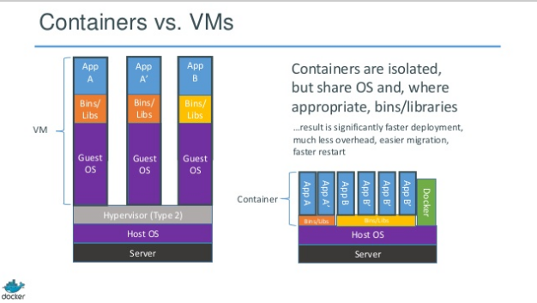

Slide 3
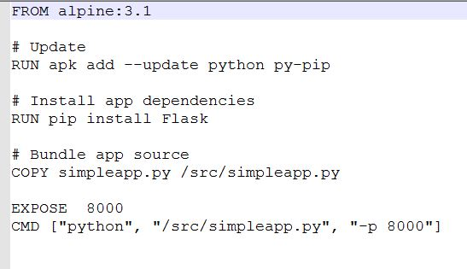
DEMO
Create a DOCKERFILE

Slide 4
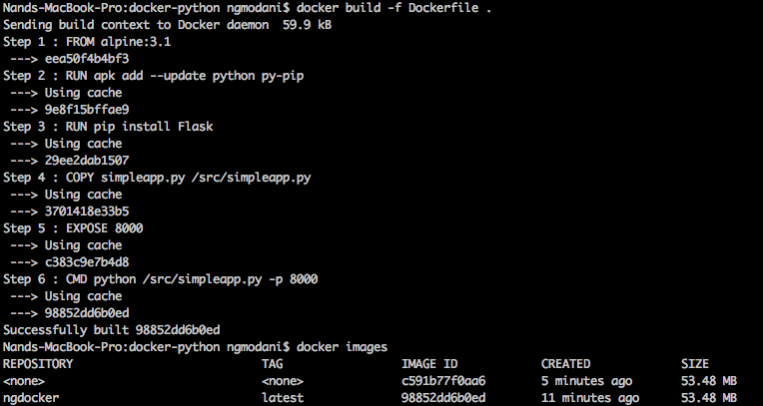
Commands

Slide 5
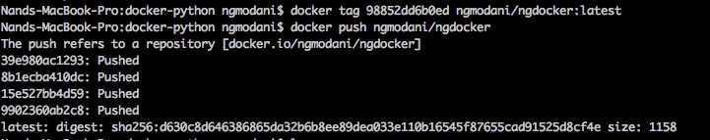

Slide 6
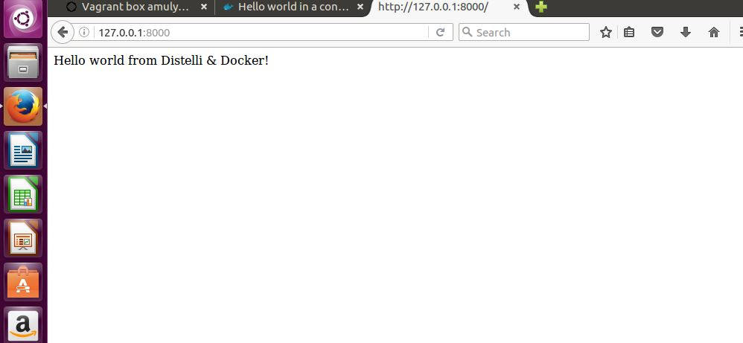

Slide 7
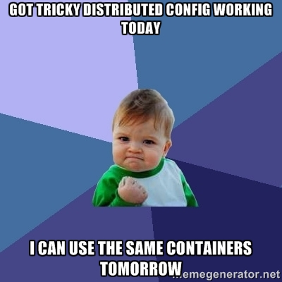
Use Cases
DOCKER FOR LOCAL APPLICATION DEVELOPMENT AND TEST
PRINCIPLE - Works on my machine → Works again on my machine tomorrow → Works on a test machine

Slide 8
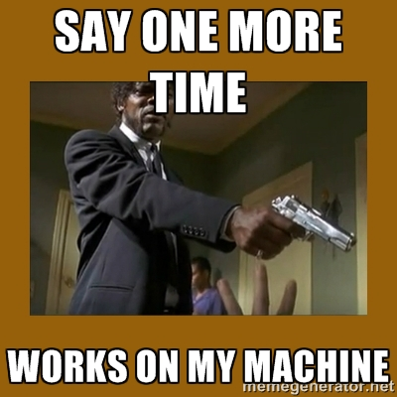
DOCKER FOR DEVELOPMENT TEAM COLLABORATION
members of a development team that need to work together on the same codebase.
PRINCIPLE Works on my machine → Works on your machine

Slide 9
App Isolation
Moving an application seamlessly through all the life cycle (development, various stages of testing, staging, production)
simplify complex deployments

